Slide 1
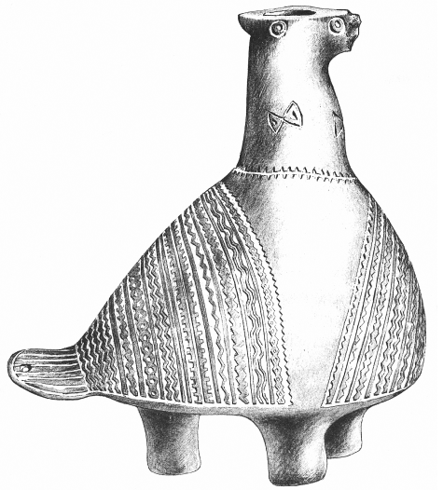
Approaches to Collaborative Multilingual Thesauri Development in Educational Context
Goran Zlodi, Tomislav Ivanjko
University of Zagreb, Faculty of Humanities and Social Sciences / Department of
Information and Communication, Zagreb, Croatia
DARIAH-EU Virtual Annual Event 2020- Zagreb, November 12 2020.
Notes:
Good afternoon everyone. My name is Goran Zlodi and I would like to present you a project coordinated by my colleague Tomislav Ivanjko and me.

Slide 2
Collaborative Multilingual Thesauri Development in Educational Context
What? | Model of Collaborative Terminology Contribution to the Art & Architecture Thesaurus (AAT)
Where? | University of Zagreb, Faculty of Humanities and Social Sciences
When? | 2019/20 academic year
Who? | Academics, museum professionals and students
Why? | To start and accelerate translation of AAT in Croatian & enable students to learn about terminology and thesauri from real-life examples
Notes:
Project is about „Collaborative Multilingual Thesauri Development in Educational Context”
WHAT So we developed Model of Collaborative Terminology Contribution to the Art & Architecture Thesaurus (- The most important multilingual vocabulary resource for art and cultural heritage)
WHERE The project is started and coordinated at the University of Zagreb, Faculty of Humanities and Social Sciences,
WHEN: last academic year (2019/20 ak. year)
WHO = and it has been implemented through the collaboration of academics, museum professionals and students
WHY To start and accelerate translation of AAT in Croatian & enable students to learn about terminology and thesauri from real-life examples

Slide 3
Art & Architecture Thesaurus (AAT)
The AAT, as part of the Getty Vocabularies, contains multilingual structured terminology:
  to describe visual art, architecture, archaeology, archival materials, visual surrogates…
  available in Open Access as Linked Open Data (crucial for achieving global interoperability)
  AAT is multilingual (availability and visibility of cultural heritage)
  large translation projects are currently underway worldwide
Notes:
SLAJD
For example it makes possible that metadata entred in one language (Croatian) can be searched and displayed, not onli in Engish, but in all other languages included in AAT

Slide 4
Challenges and solutions
Challenges
  terminology contribution and translation projects require the engagement of experts, financial and organizational resources
Possible solution
  engagement of students through the modification of different methods from crowdsourcing projects (motivation, quality control)
  it is necessary to be aware that we are in an educational context (neither are students a crowd, nor is the point in using students to just do some work)
  academic crowdsourcing (edusourcing)
Notes:
But there are some chalenges,
So there is one Possible solution

Slide 5
Participants
Experts:
  Museum professionals (Ethnographic Museum, Museum of contemporary art, …)
  University professors
Students attending the course „Documentation in Museum” (double major students:
Information Sciences – Museology +
Humanities or Language subjects):
  Student group 1, 20 participants (SG1)
  Student group 2, 5 part. (SG2) - volunteers!
Notes:
In our model there are two major groups of participants: Experts and Students
In the Expert group there are museum prof. from several museums, and uni professors (that means Tomislav and me)
Among students attending the course "Documentation in museum"( they are double major students: Information Sciences - Museology as one subject & one of the Humanities or Language subjects, as other) here are:
Student group 1 - in which are all TWENTY participants of course
and Student group 2, a special group of 5 students – volunteers, who invest their free time in the project

Slide 6
Assign the necessary expert roles to the participants
Terminology translation: expertise required | Participants
 | Experts (Museum professionals, academics, researchers) | Students (SG1 & SG2 student groups)
Content experts | Museum professionals, academics, researchers. | Students in humanities study groups (e.g., art history, archaeology, history, cultural anthropology).
Language experts | Translators, museum professionals, academics, researchers. | Students of language study groups (e.g. English, Italian…).
Thesaurus experts | Academics (information sciences and museology professors). | Students of information sciences (e.g. museology, librarianship, archivists).
Technical experts | Academics (information sciences and museology professors). | Students of information sciences.
Project coordinators | Academics (information sciences and museology professors). | Students of information sciences.
Notes:
The process of translating terminology and building a thesaurus is an interdisciplinary work and the following experts are needed:
--------------------------------
Therefore expert roles are assigned to the participants as follows:
obviously, to experts in the particular fields
and to students according to their subjects

Slide 7
Stage 1. Selection of terms
Selection of terms from the following key domains:
  materials, techniques, styles and periods, object names and the author roles (key metadata categories)
  The most frequent terms (N=2000) from the above categories were selected from the partner institutions' collection management databases (most common terminology!)
Notes:
Here is the workflow (developed by AAT guidelines for translation projects, but also by methods of academic crowdsourcing)
In the first stage, we decided to chose terms from following domains:
materials, techniques, styles and periods, object names and author roles
(All key metadata categories )
from the domains above the two thousand most frequently used terms were selected from the partner institutions' databases
I would like to emphasize that this is the most common terminology (which it would be desirable for students to know) - not some special terminology (eg classical architecture - which would require a different approach)

Slide 8
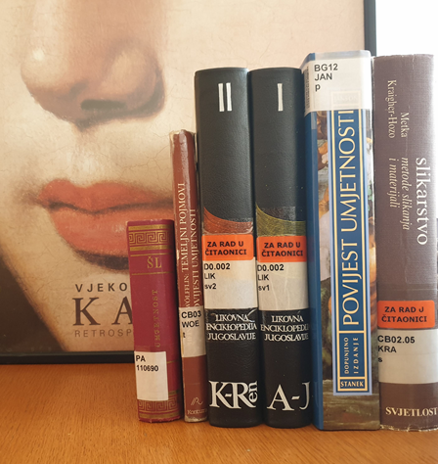
Stage 2. Selection of reference sources
The selection of authoritative scholarly sources and general reference works was carried out through:
  analysis of literature of a series of courses (programs of art history, archaeology and ethnology and cultural anthropology)
  further consultations with experts
Notes:
In the second stage the selection of scholarly sources and general reference works was carried out
through the analysis of the required and optional literature of a series of courses
and through the further consultations with experts

Slide 9
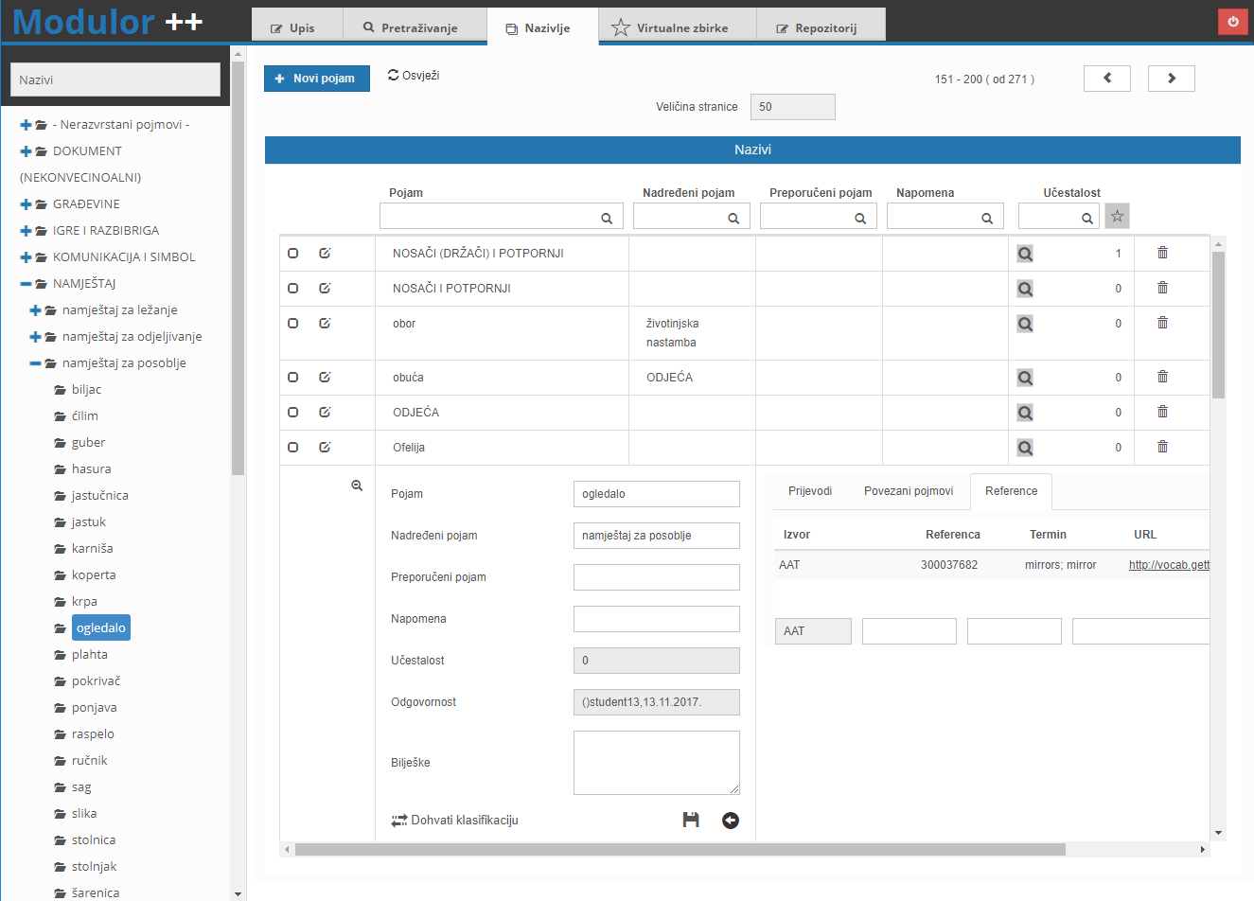
Stage 3. Terms translation and mapping
Activities carried out by
Student group 1 (20 students)
  Each individual Croatian term is searched in the following online accessible encyclopedias and lexicographic sources:
    The Croatian encyclopaedia
    The Proleksis encyclopaedia online
    STRUNA - Database of Croatian Special Field Terminology
  Translation of Scope notes (definitions) from AAT to Croatian
  Comparing of AAT definitions with definitions from sources
  Mapping and linking terms to AAT (via SPARQL or manually)
Notes:
In the third stage, that is carried out by all twenty students at course (SG1), The following steps have been taken:
Each individual Croatian term is searched in the following online encyclopedias
scope notes from AAT are translated into Croatian,
AAT definitions are compred with definitions from sources,
and finally Mapping and linking Croatian terms to AAT (was made via SPARQL or manually)

Slide 10
Stage 4. Proof-checking and quality control
Carried out by Student group 2
(5 students - volunteers):
selected literature research (while SG1 consult only online sources, SG2 consult also extensive printed sources)
recording references and definitions from Croatian reference sources
proof-checking the mapping that the SG1 group worked on
categorization of errors, if any (for example: mapping of concepts with different scopes)
Notes:
In the fourth stage, students of special group 2 carried out:
selected literature research (while first group consults only online sources, second group (volontiers) consults also extensive printed sources)
then students documented and cited references and definitions
they proof-checked the mapping that student group 1 had worked on
and finally they categorized errors, if any ((for example: in thesauri, mapping of concepts with slightly different scopes (broader or narrower) are not allowed))

Slide 11
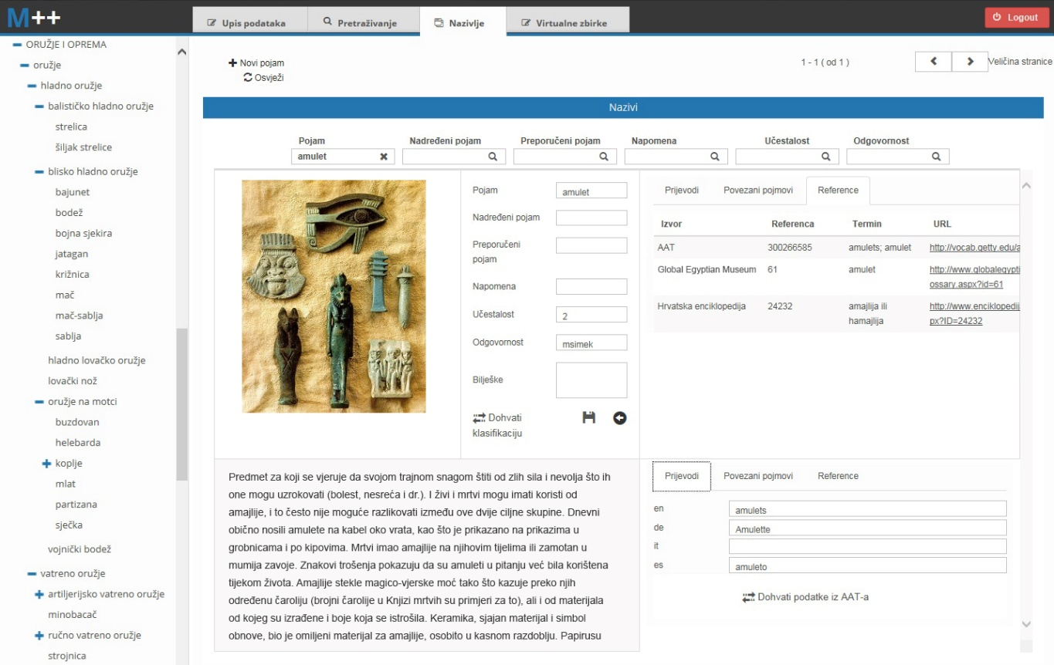
Stage 5. Review and final verification
Carried out by Experts
  All terms, mappings and translations was reviewed and verified
  Only the terms that the students categorized as particularly demanding were given for translation to experts
  After review and verification, terms are designated as suitable for export to the AAT (at the moment more than 500 terms verified)
Notes:
In the fifth stage, which was carried out by experts
Only the terms that students categorized as particularly demanding were given for translation to experts (this saved time for experts)
After review and verification of all terms - more than five hundred terms have been designated as suitable for export to the AAT

Slide 12
Cognitive domains of edusourcing in terminology development according to Bloom’s taxonomy
Level | Actions | Outcome
Knowledge | define, list, name, order, recognize, relate, recall, repeat | Gathering term definitions enables students to define, list and recognize basic field terminology
Comprehension | classify, discuss, explain, identify, indicate, report, review, select | Translation of the terms enable students to classify, discuss and select appropriate terminology within the field
Application | apply, choose, demonstrate, sketch, solve, use, write | Linking the terms to the AAT enables students to apply and demonstrate their knowledge in a structured terminology environment. Referring to sources.
Analysis | analyse, calculate, compare, contrast, discriminate, examine, experiment | Comparing the work process and results between different students enables them to analyse and compare their own knowledge
Synthesis | assemble, construct, create, design, develop, formulate, prepare, propose, write | Incorporating the results within a coherent AAT structure enables students to gain valuable insight into the construction and maintenance of controlled vocabularies.
Evaluation | assess, attach, choose, compare, predict, rate, select, evaluate | Performing quality control enables a student to compare and evaluate different approaches through peer-checking
Notes:
And in blue (
Please check
especially annotating, comparing, referring and representing
Functional …
linking

Slide 13
Further research needed
Utilization and improvement of the model
  How to improve translations and quality control?
  What terms, from which domains, to assign to a student from which study groups?
  To what extent is student engagement acceptable (special terminology)?

Slide 14
Conclusions
the proposed collaborative model can facilitate the contribution of terms to a multilingual thesaurus and ensure the quality of the process
at the same time students can reach desired learning outcomes on real-life project
the new multilingual terminology is available to everyone (machines & humans) for reuse through Linked Open Data (LOD)
increased availability and visibility of cultural heritage
Notes:
Which as I said – can increase availability and visibility of cultural heritage
n

Slide 15
Thank you for attention! gzlodi@ffzg.hr tivanjko@ffzg.hr

