Slide 1
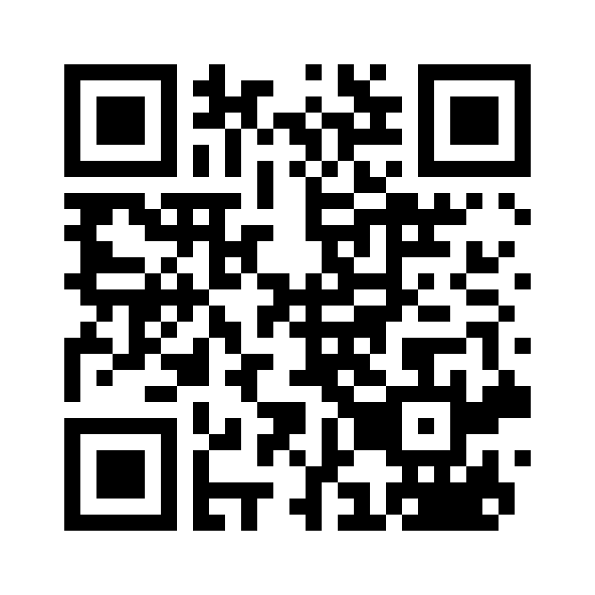
INDIVIDUAL-LEVEL MULTICULTURALISM AND CULTURAL INTELLIGENCE
Ana Butković, Department of Psychology, Faculty of Humanities and Social Sciences, University of Zagreb, Croatia, abutkovic@ffzg.unizg.hr
Irma Brković, Department of Pedagogical, Curricular and Professional Studies, University of Gothenburg, Sweden, irma.brkovic@gu.se
Gordana Keresteš, Department of Psychology, Faculty of Humanities and Social Sciences, University of Zagreb, Croatia, gkerestes@ffzg.unizg.hr
Ivona Grgurinović, Department of Ethnology and Cultural Anthropology, Faculty of Humanities and Social Sciences, University of Zagreb, Croatia, igrgurin@ffzg.unizg.hr
Melita Puklek Levpušček, Department of Psychology, Faculty of Arts, University of Ljubljana, Slovenia, Melita.PuklekLevpuscek@ff.uni-lj.si
INTRODUCTION
Today’s society is becoming increasingly culturally diverse which means that individual differences in the capability to function effectively in situations characterized by cultural diversity, which is defined as cultural intelligence (CQ; Ang & Van Dyne, 2008), are becoming more important for every day functioning. As societies become more culturally diverse, so do the classrooms. Olsson (2022) reports that around 40% of preschoolers in Sweden in 2020 were coming from families with culturally diverse backgrounds. Early and Ang (2003) first introduced the concept of CQ and conceptualized it as a multidimensional construct comprising four dimensions – metacognitive, cognitive, motivational and behavioral CQ.
Multiculturalism, defined as the experience of having been exposed to and having internalized two or more cultures (Hong et al., 2000; Nguyen & Benet-Martínez, 2007), is a relatively new antecedent of CQ examined in the literature. Korzilius et al. (2017) found in a sample of employees in the Netherlands that individuals who reported higher multiculturalism had a higher total CQ score. In another study in the US results showed that business students with bicultural identity who perceived their cultural identities as integrated and compatible had higher cognitive and metacognitive CQ (Dheer & Lenartowicz, 2018).
Recently Vora et al. (2019) suggested studying the phenomenon of individual-level multiculturalism, which encompasses three necessary conditions – a degree of knowledge of, identification with, and internalization of more than one societal culture. The aim of this study was to examine the association between individual-level multiculturalism and four different aspects of CQ (metacognitive, cognitive, motivational, behavioral) in a sample of teachers and student teachers in Sweden.
METHOD
RESULTS
Data were collected for 99 (68% female; 79% student teachers; M_{age} = 34.20, SD = 10.51) participants with an online questionnaire.
CQ was measured with the Cultural Intelligence Scale (Van Dyne et al., 2008), which has 20 items, with 4 measuring metacognitive (I am conscious of the cultural knowledge I apply to cross-cultural interactions), 6 cognitive (I know the cultural values and religious beliefs of other cultures), 5 motivational (I enjoy living in cultures that are unfamiliar to me) and 5 behavioral (I change my nonverbal behavior when a cross-cultural situation requires it) CQ. Participants had to indicate, for each item, how well it describes their capabilities, i.e. to which extent they agree with the list of statements, on a scale ranging from 1 (strongly disagree) to 7 (strongly agree). Cronbach alpha reliabilites were in the .73-.84 range for all four scales.
Following Vora et al. (2019), three items measuring knowledge, identification and internalization were used to assess multiculturalism. Participants had to indicate for each item, whether it truely describes them on a scale ranging from 1 (untrue of me) to 5 (true of me). Cronbach alpha reliability was .76.
Table 1. Descriptive statistics and correlations for Cultural Intelligence Scale and multiculturalism.
 | M | SD | CQ_MC | CQ_C | CQ_M | CQ_B
CQ_MC | 4.83 | 1.05
CQ_C | 4.19 | 1.09 | .64
CQ_M | 4.78 | 1.18 | .59 | .59
CQ_B | 4.50 | 1.07 | .51 | .50 | .36
MC | 2.92 | 1.00 | .43 | .55 | .50 | .14
Note. All correlations in bold are significant at p ≤.001; M = arithmetic mean; SD = standard deviation; CQ_MC = metacognitive cultural intelligence; CQ_C = cognitive cultural intelligence; CQ_M = motivational cultural intelligence; CQ_B = behavioral cultural intelligence; MC = multiculturalism.
CONCLUSIONS
In line with previous studies (Dheer & Lenartowicz, 2018; Korzilius et al., 2017) we found CQ to be positively associated with multiculturalism. In addition, there are three important contributions of our study. We measured individual-level multiculturalism, which encompassed a degree of knowledge of, identification with, and internalization of more than one societal culture. We showed that it is important to examine all CQ dimensions because it seems that they are not necessarily all associated with multiculturalism. Finally, this was, to our knowledge, the first study that examined these associations in student teachers and teachers.
These results have implications for the CQ development programs. Since classrooms are becoming more culturally diverse, a teacher’s capability to function effectively in situations characterized by cultural diversity, in other words their CQ, becomes an important set of skills to have and develop. Therefore, teacher educators need to know which factors contribute to higher CQ in student teachers and teachers so that they can develop efficient programs for CQ development and integrate this knowledge in curricula.
References
Ang, S., & Van Dyne, L. (2008). Conceptualization of cultural intelligence: Definition, distinctiveness, and nomological network. In S. Ang & L. Van Dyne (Eds.), Handbook of cultural intelligence: Theory, measurement, and applications (pp. 3 – 15). M.E. Sharpe.
Dheer, R. J., & Lenartowicz, T. (2018). Multiculturalism and entrepreneurial intentions: Understanding the mediating role of cognitions. Entrepreneurship Theory and Practice, 42(3), 426-466.
Earley, P. C., & Ang, S. (2003). Cultural intelligence: Individual interactions across cultures. Stanford University Press.
Hong, Y. Y., Morris, M. W., Chiu, C. Y., & Benet-Martinez, V. (2000). Multicultural minds: A dynamic constructivist approach to culture and cognition. American Psychologist, 55(7), 709-720.
Korzilius, H., Bücker, J. J., & Beerlage, S. (2017). Multiculturalism and innovative work behavior: The mediating role of cultural intelligence. International Journal of Intercultural Relations, 56, 13-24.
Nguyen, A. M. D., & Benet‐Martínez, V. (2007). Biculturalism unpacked: Components, measurement, individual differences, and outcomes. Social and Personality Psychology Compass, 1(1), 101-114.
Olsson, Å. (2022). Multicultural preschools in Sweden: Principals’ views on challenges and opportunities. World Studies in Education, 23(1), 59-76.
Van Dyne, L., Ang, S., & Koh, C. (2008). Development and validation of the CQS: The cultural intelligence scale. In S. Ang & L. Van Dyne (Eds.), Handbook of cultural intelligence: Theory, measurement, and applications (pp. 16-38). M.E. Sharpe.
Vora, D., Martin, L., Fitzsimmons, S. R., Pekerti, A. A., Lakshman, C., & Raheem, S. (2019). Multiculturalism within individuals: A review, critique, and agenda for future research. Journal of International Business Studies, 50, 499-524.
This work was supported by Faculty of Humanities and Social Sciences institutional research projects (Grant No. 11-933-1006).

